Slide 1

Case studies in networks
How information spreads through networks
David J.P. O’Sullivan
osullivan@maths.ox.ac.uk

Slide 2
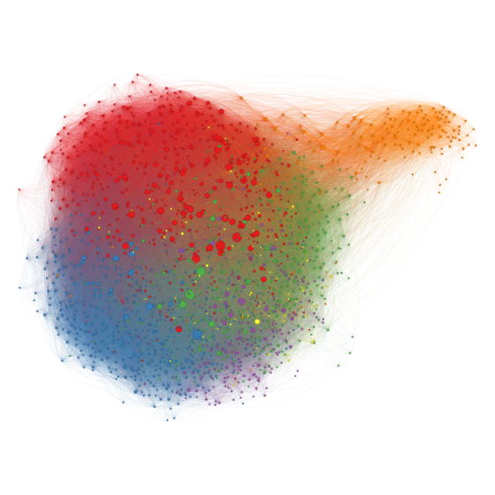

What were going to talk about
Case studies in network analysis
Going to go through some of my work
Use this as an excuse to introduce some ideas
Today network structure
Tomorrow cascades and customer churn
Notes:
Do normally talk a break?

Slide 3
What were going to talk about
GitHub
Code to recreate some of the analysis here
Data to have a play with
More on that later
Papers that I talk about
Links to books
Links tutorials in R
https://github.com/DavidJPOS/CaseStudiesInNetworks

Slide 4
What were going to talk about
The kind of things I'm interested in
Using network science and statistics to answer interesting questions and building tools for social science
How people self sort into groups (communities)
What this means for the spread of information on networks
Collective behaviour
Make makes people change their behaviour?
We’ll briefly talk on how network are used for this
(always coming back to the data)

Slide 5
A little break to play with R
Basics of R and the tidyverse
Interactive demo 1 & 2

Slide 6
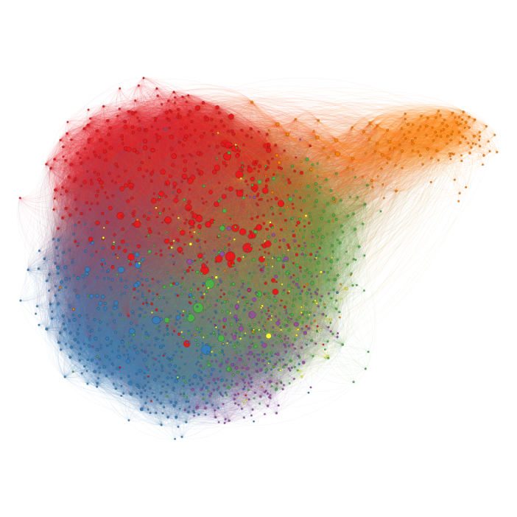
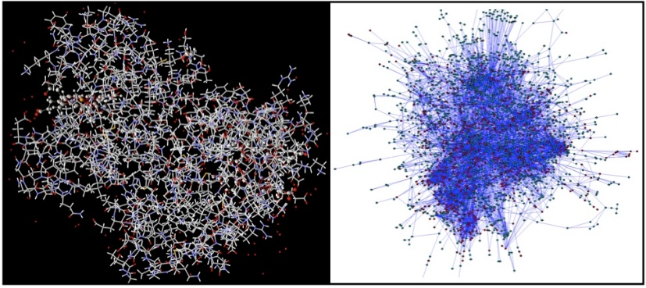
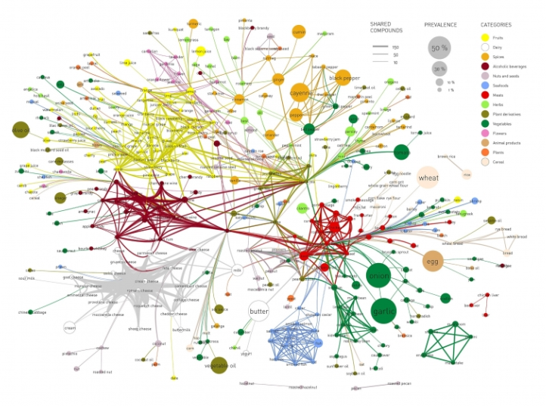
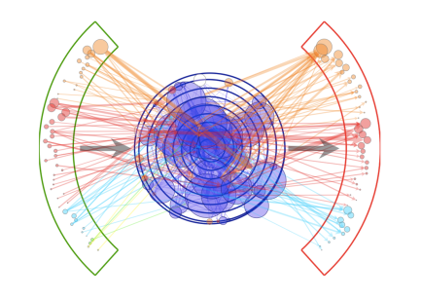
Basics of network theory
What is a network?
Social networks
Biological networks
Financial network

Slide 7
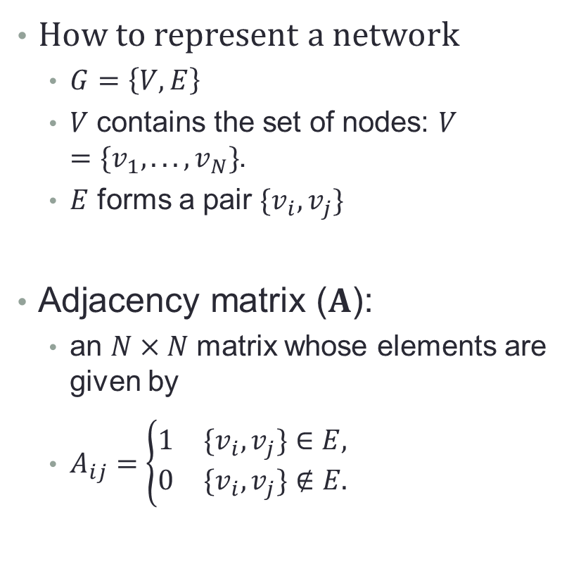
Basics of network theory
How to represent a network
$G=\left\{V,E\right\}$
$V$ contains the set of nodes: $V=\{v_{1},...,v_{N}\}$.
$E$ forms a pair $\{v_{i},v_{j}\}$
Adjacency matrix ($A$):
an $N×N$ matrix whose elements are given by
$A_{ij}=\left\{\begin{matrix}1 & \{v_{i},v_{j}\}∈E, \\ 0 & \{v_{i},v_{j}\}∉E.\end{matrix}\right.$

Slide 8
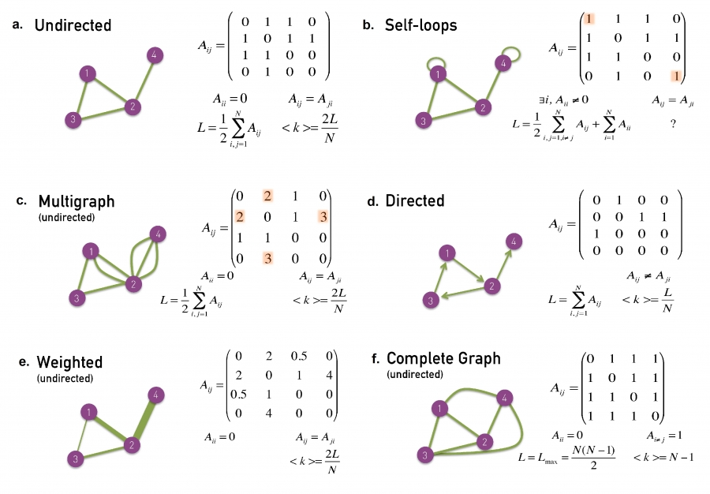
Basics of network theory

Slide 9
Basics of network theory

Slide 10
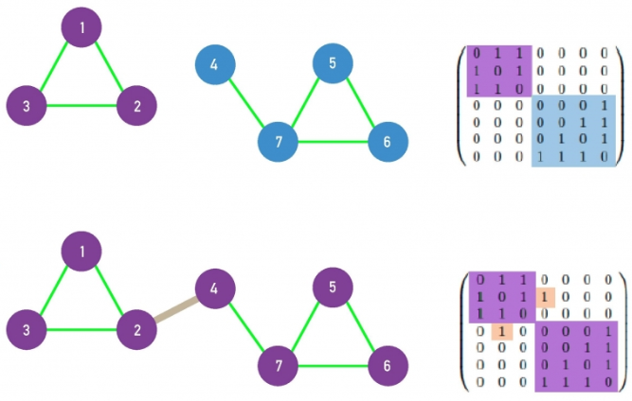
Basics of network theory
Connectedness
Is the graph fractured into smaller parts?
One big group?
Fully connected

Slide 11
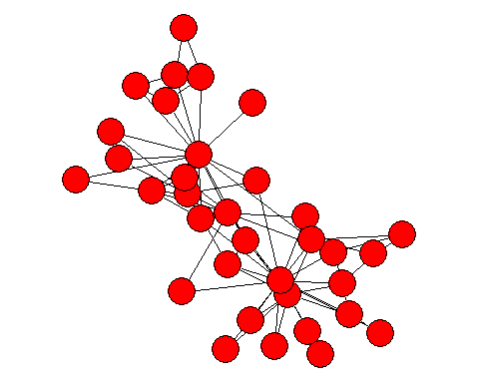
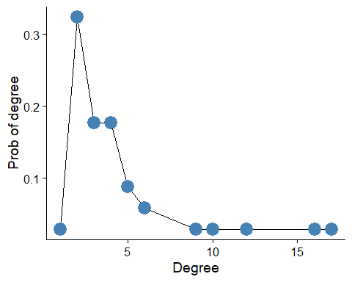
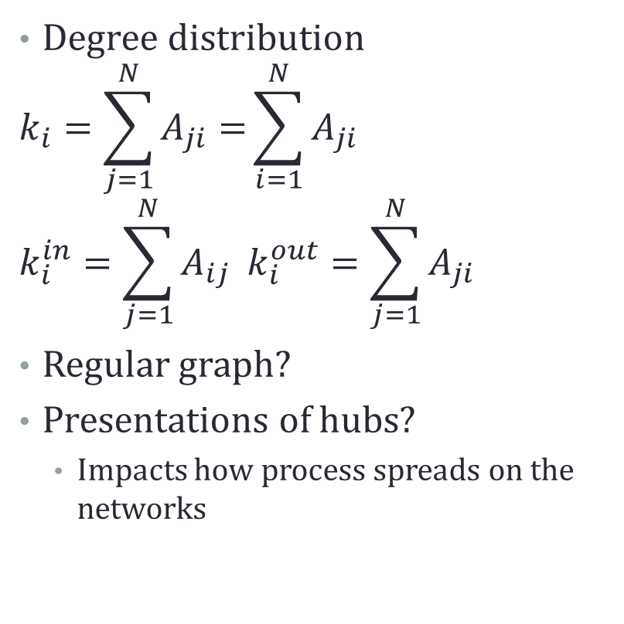
Basics of network theory
Degree distribution
$$k_{i}=\sum_{j=1}^{N}{A_{ji}=}\sum_{i=1}^{N}{A_{ji}}$$
$$k_{i}^{in}=\sum_{j=1}^{N}{A_{ij}} k_{i}^{out}=\sum_{j=1}^{N}{A_{ji}}$$
Regular graph?
Presentations of hubs?
Impacts how process spreads on the networks

Slide 12
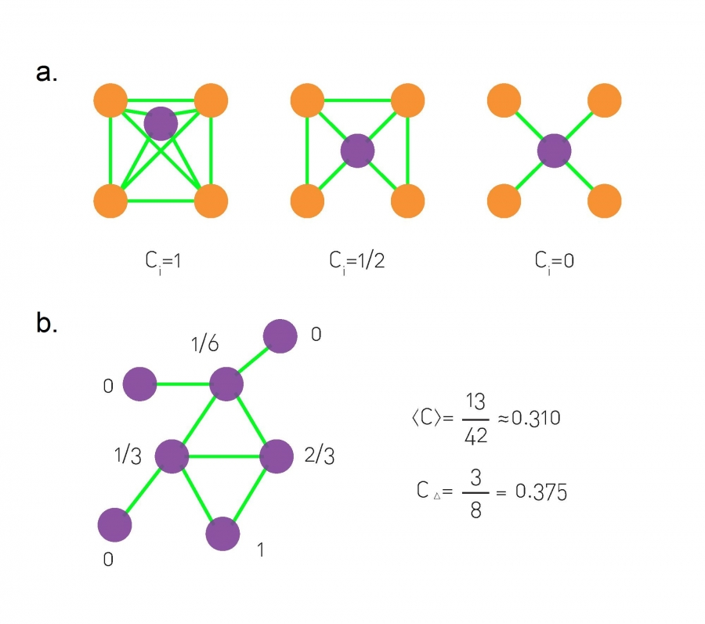
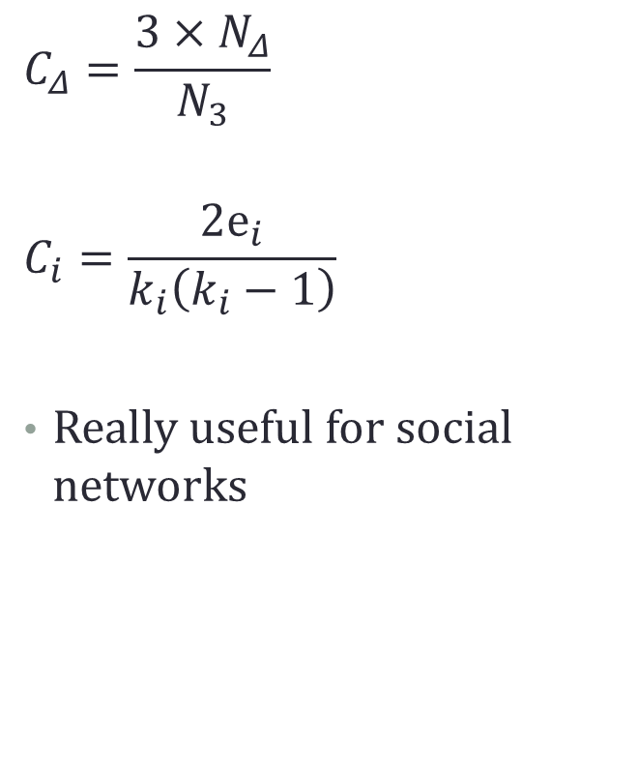
Basics of network theory
$$C_{Δ}=\frac{3×N_{Δ}}{N_{3}}$$
$$C_{i}=\frac{2e_{i}}{k_{i}\left(k_{i}−1\right)}$$
Really useful for social networks

Slide 13
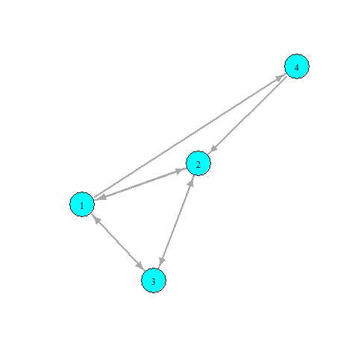
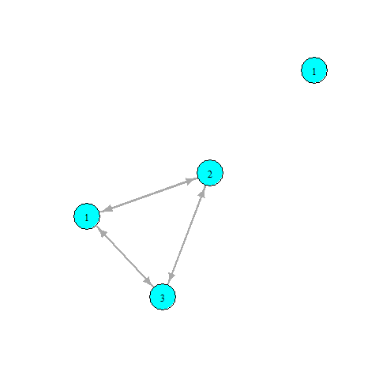
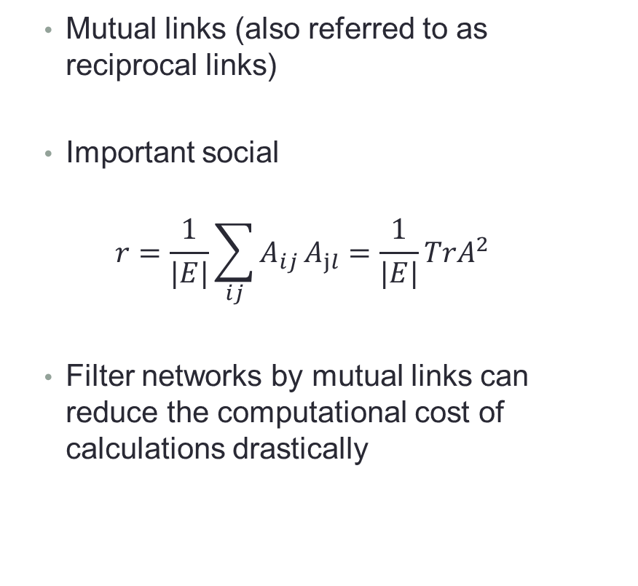
Basics of network theory
Mutual links (also referred to as reciprocal links)
Important social
$$r=\frac{1}{|E|}\sum_{ij}^{​}{A_{ij}}A_{jl}=\frac{1}{|E|}TrA^{2}$$
Filter networks by mutual links can reduce the computational cost of calculations drastically

Slide 14
A little break to play with R
Creating and plotting simple graphs in R
1_introduction.r

Slide 15
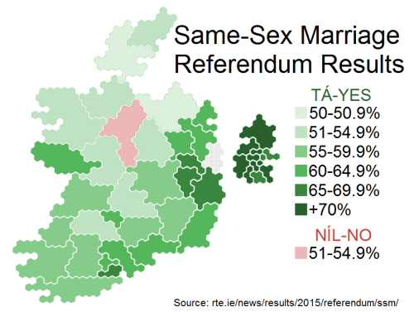
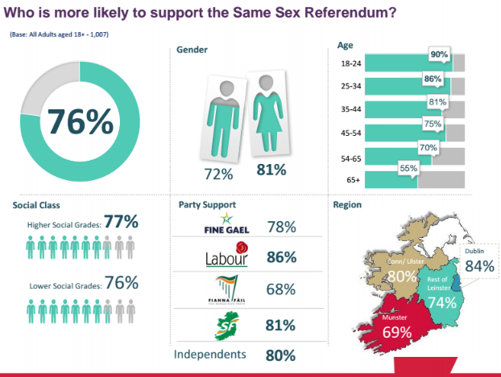
Irish Marriage Referendum Data
Irish Marriage referendum
22nd of May 2015
Passed by a 62% majority
High voter turn out 60%
I was interested in Twitter data
Collected an extensive dataset
“#marriageref” & “#marref”
7th and the 23rd of May
144,077 users & 499,642 tweets

Slide 16
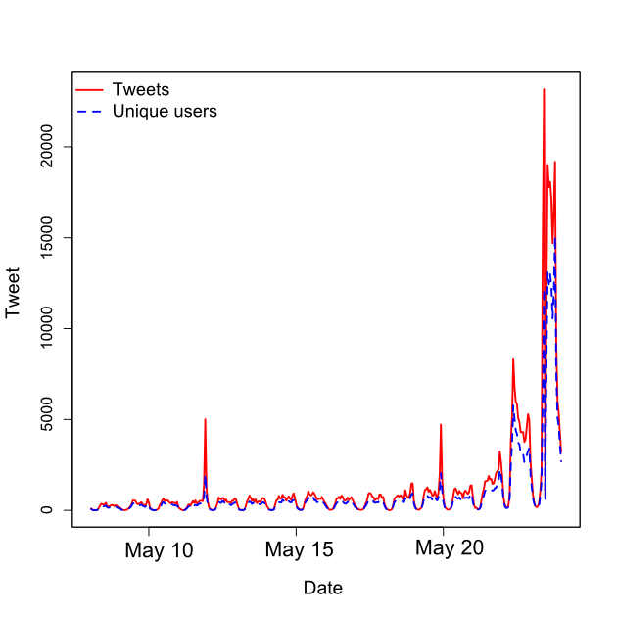

Irish Marriage Referendum Data
Each tweet contained
20 variables
Screen name
Time stamp
Text
Geolocation, etc
For each user
22 variables
Screen name
Description, etc
Friends list
177,669,550 directed links between users
First step?

Slide 17
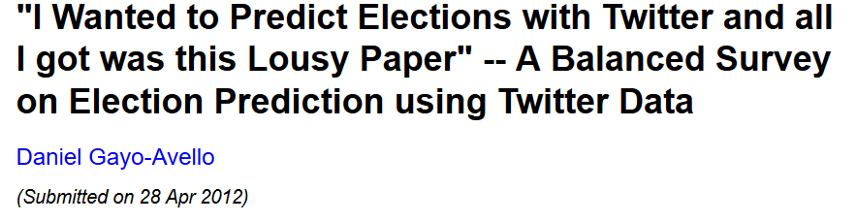
Irish Marriage Referendum Data
Just a work of warning
A lot of people have tried to predict stuff with twitter data…
Why?
Twitters API’s give a sample
And worse again probably not random sample
Demographically not representative
Geographically not representative
Activity rates between users differ... A lot!

Slide 18
Irish Marriage Referendum Data
But with those in mind…
Interested in sentiment on networks
How positive or negative content/users are
Does sentiment matter?
Sentiment sent and received?
Does sentiment cluster between users
Proxy for homophily?
Is it useful for classification of voters
Can we find yes and no voters?

Slide 19
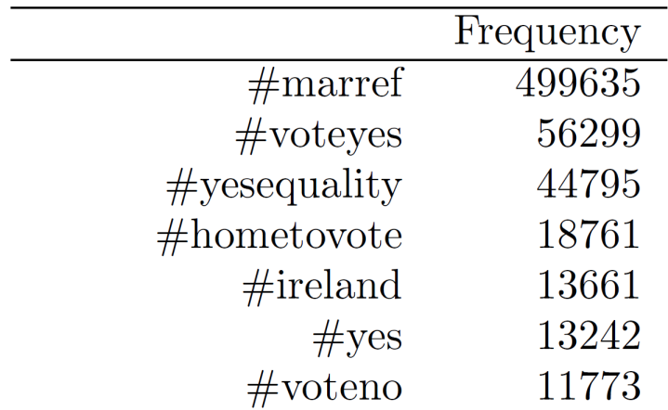
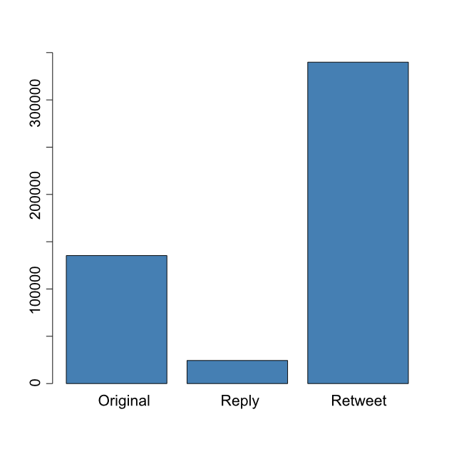



Data collection
#marref – very popular hashtag
#marriageref
not very popular (397)
Types of tweets
Of the 499,642
Original 135,370 (27%)
Reply 24,397 (5%)
Retweet 339,875 (86%)
Next step, homophily (sentiment)

Slide 20
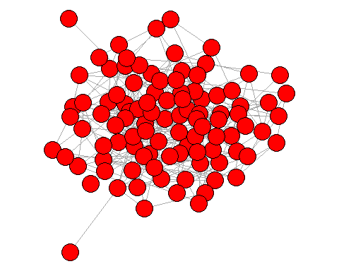
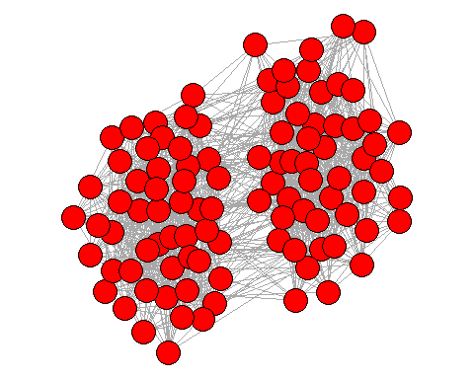
Homophily, what is it?
‘Birds of a feather flock together’
Do you see any homophily?
What drives homophily
For music preferences?
For sport team?

Slide 21
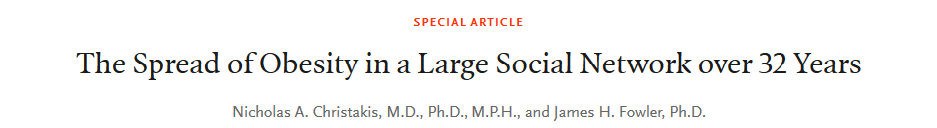
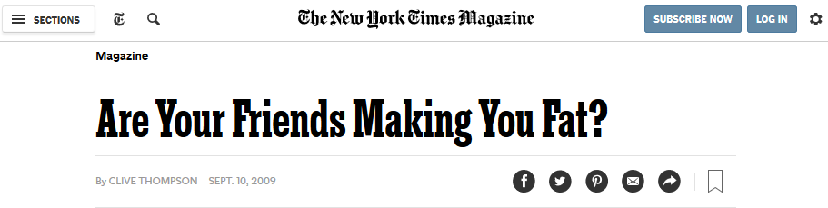
Homophily, what is it?
Very popular area in the social science
Very popular area in the social science
Leads to none articles like this….

Slide 22
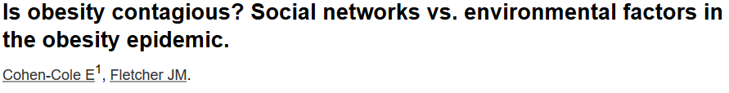
Homophily, what is it?
Tracked peoples BMI and social contact over time
How likely are we to be connected to other people with similar BMI?
Made casual claims that it ‘spreads’
Problem with confounders
Environmental factors
Geography
Age
Etc.

Slide 23

Homophily, what is it?
Correlation does not imply causation
Spurious correlations is a great website
Ideally, in this setting, how would you prove this is ‘contagious’? (what the gold standard)?

Slide 24
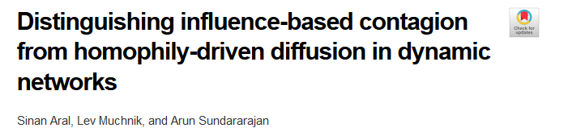
Homophily, what is it?
So, how can you differentiae between social and environment effects?
Partnered with Yahoo
30 million users Yahoo chat user
Over 6 months
Adoption of a new product
Extensive demographics information

Slide 25
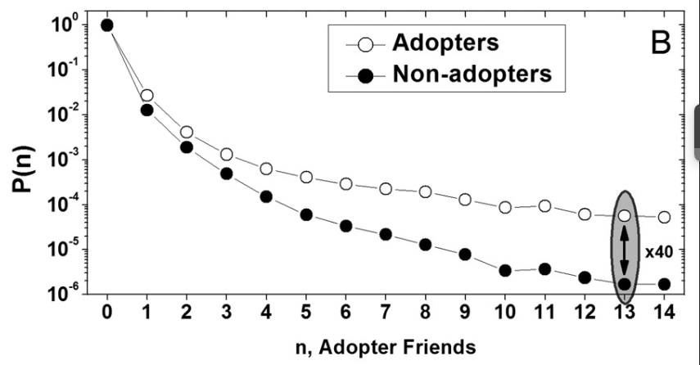
Homophily, what is it?
How likely are you to about adopt given adopter neighbours
Instead of using the raw network data
Dynamic match sample estimation

Slide 26
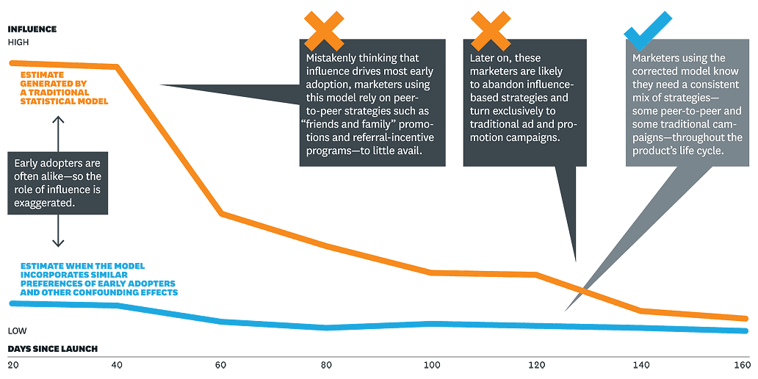
Homophily, what is it?
Self sorting of people connecting via there interests
Is this going to be a problem for us using sentiment?

Slide 27
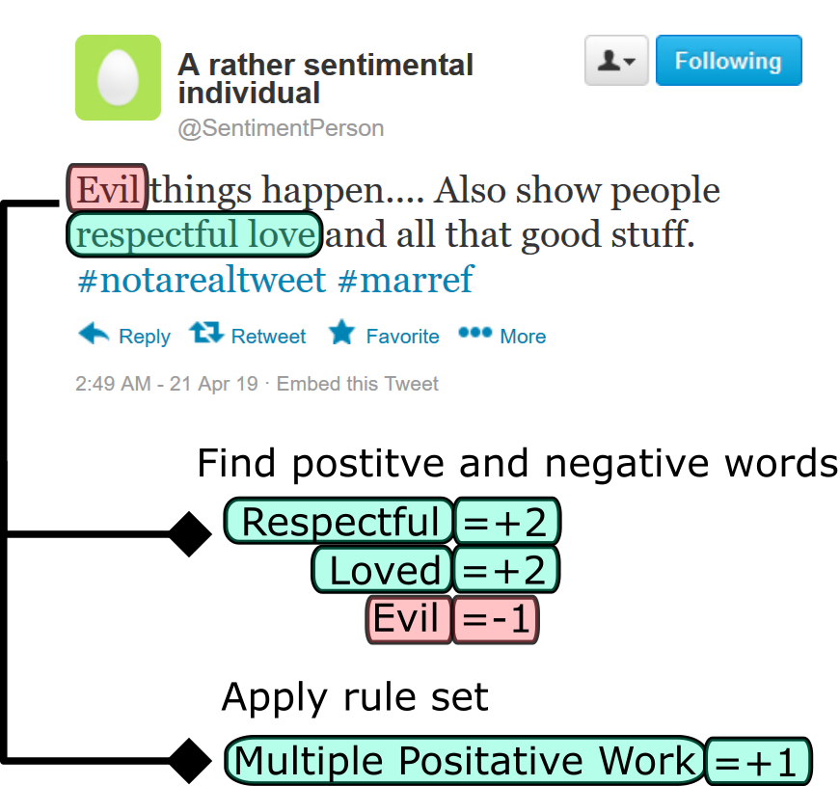
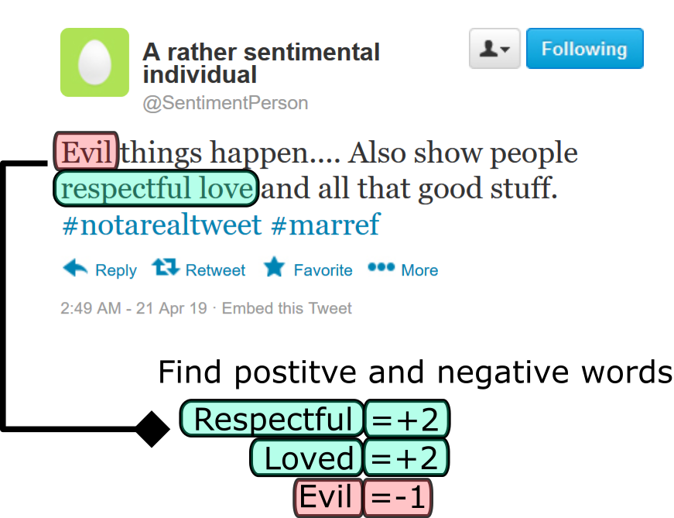
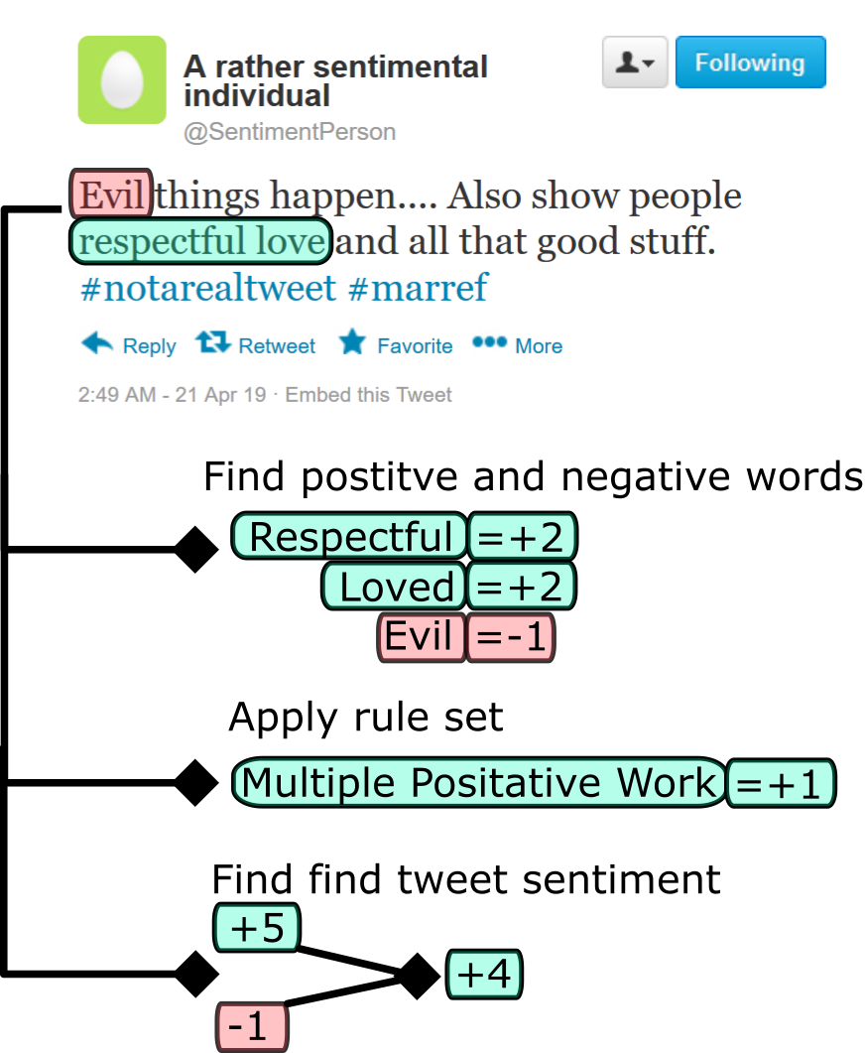
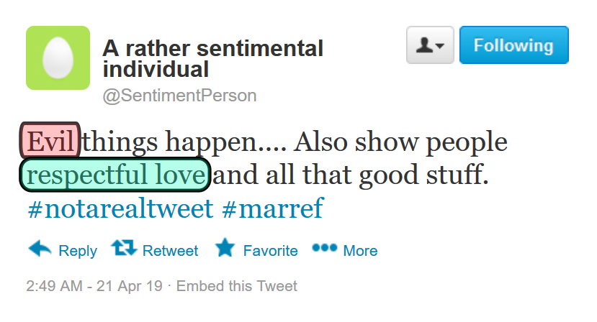
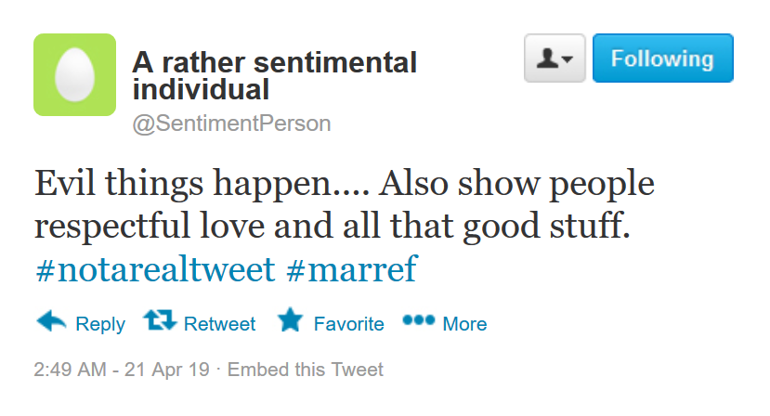
Tweet Sentiment
Find sentiment score for each tweet
How positive or negative the language is
SentiStrength¹
Calculating this for every tweet
Fine the positive and negative score
Take the difference to find a single sentiment score

Slide 28
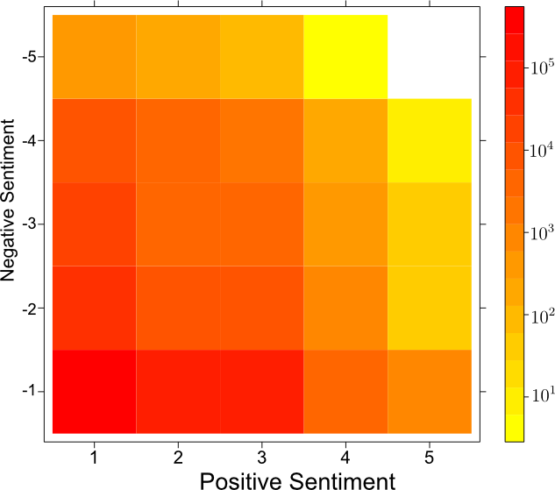
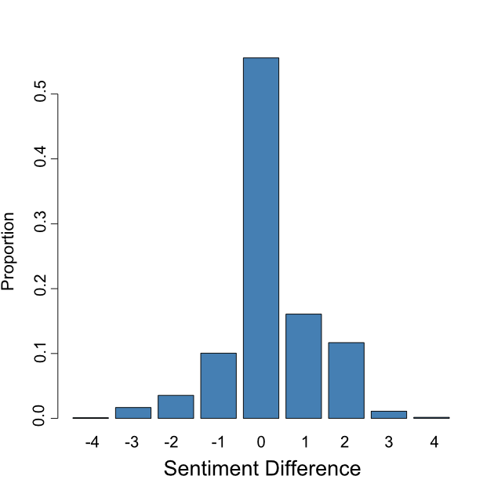
Tweet Sentiment
Distribution of scores
Scale from -4 to 4
Most tweets have 0 sentiment score (55%)
Vast majority had (-1,1) sentiment scores (95%)
Sentiment is noisy
Look to aggregate out the noise
Distribution of tweets per user
Average 4
Problematic for aggregation

Slide 29
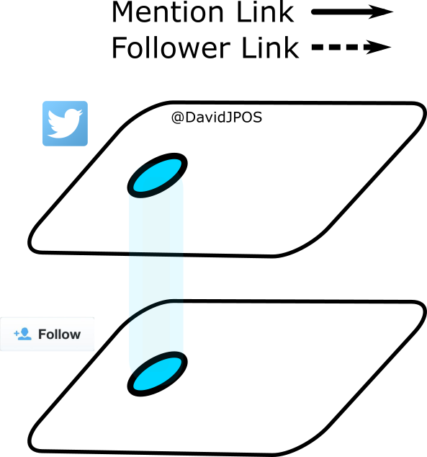
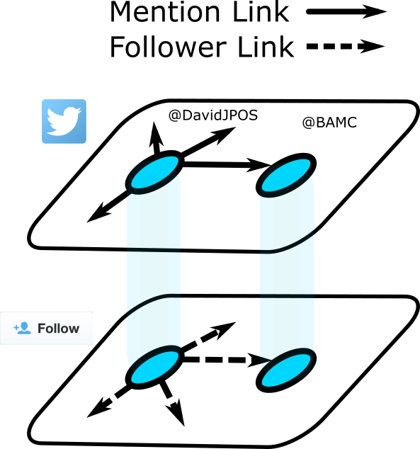
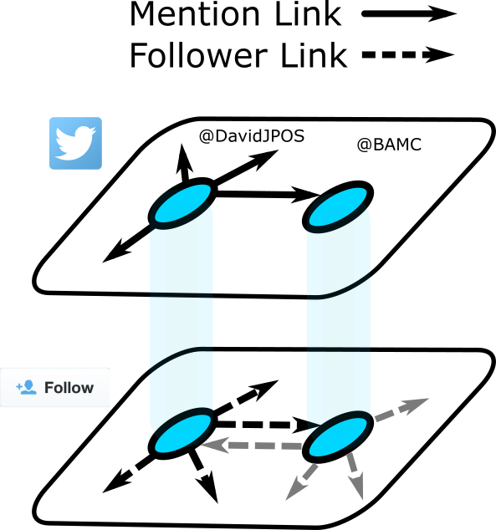
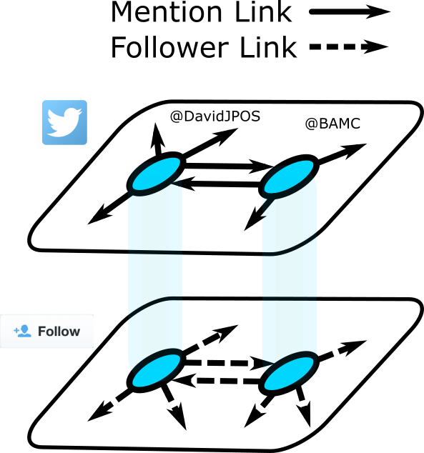

Network creation
Generate two networks
Mention – conversational
Follower – structural
Weight mention links by sentiment

Slide 30
Network creation

Slide 31
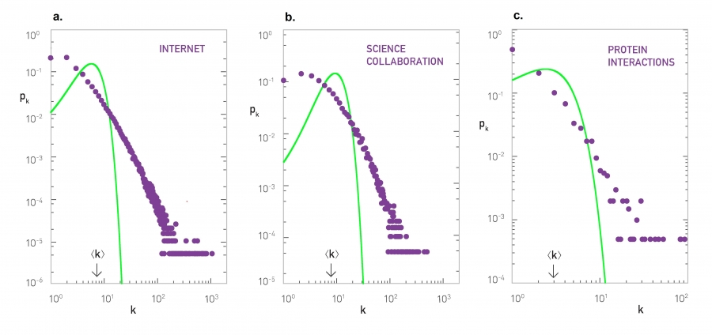
Network generation models
Erdos-Renyi model: G(N,p)

Slide 32
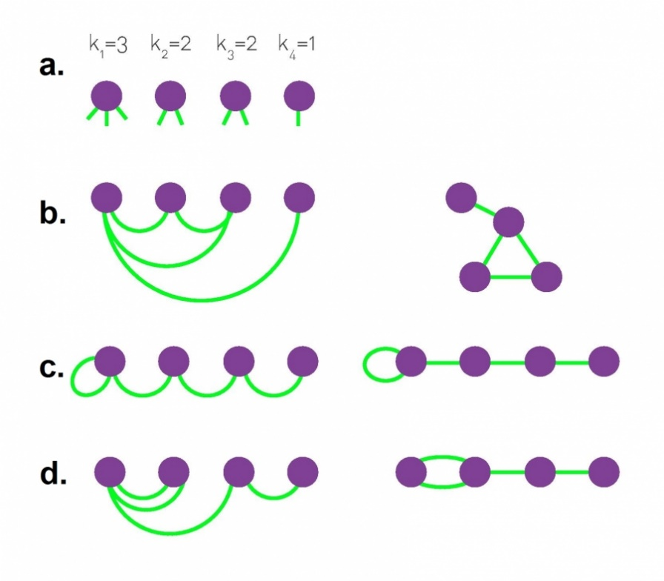
Network generation models
Configuration model
Defined degree sequence
Randomly connect ‘stubs’ together
Can contain
Multi edges
Self loops
But for large N these are small
Useful model analytically
But how close to empirical networks is it?

Slide 33
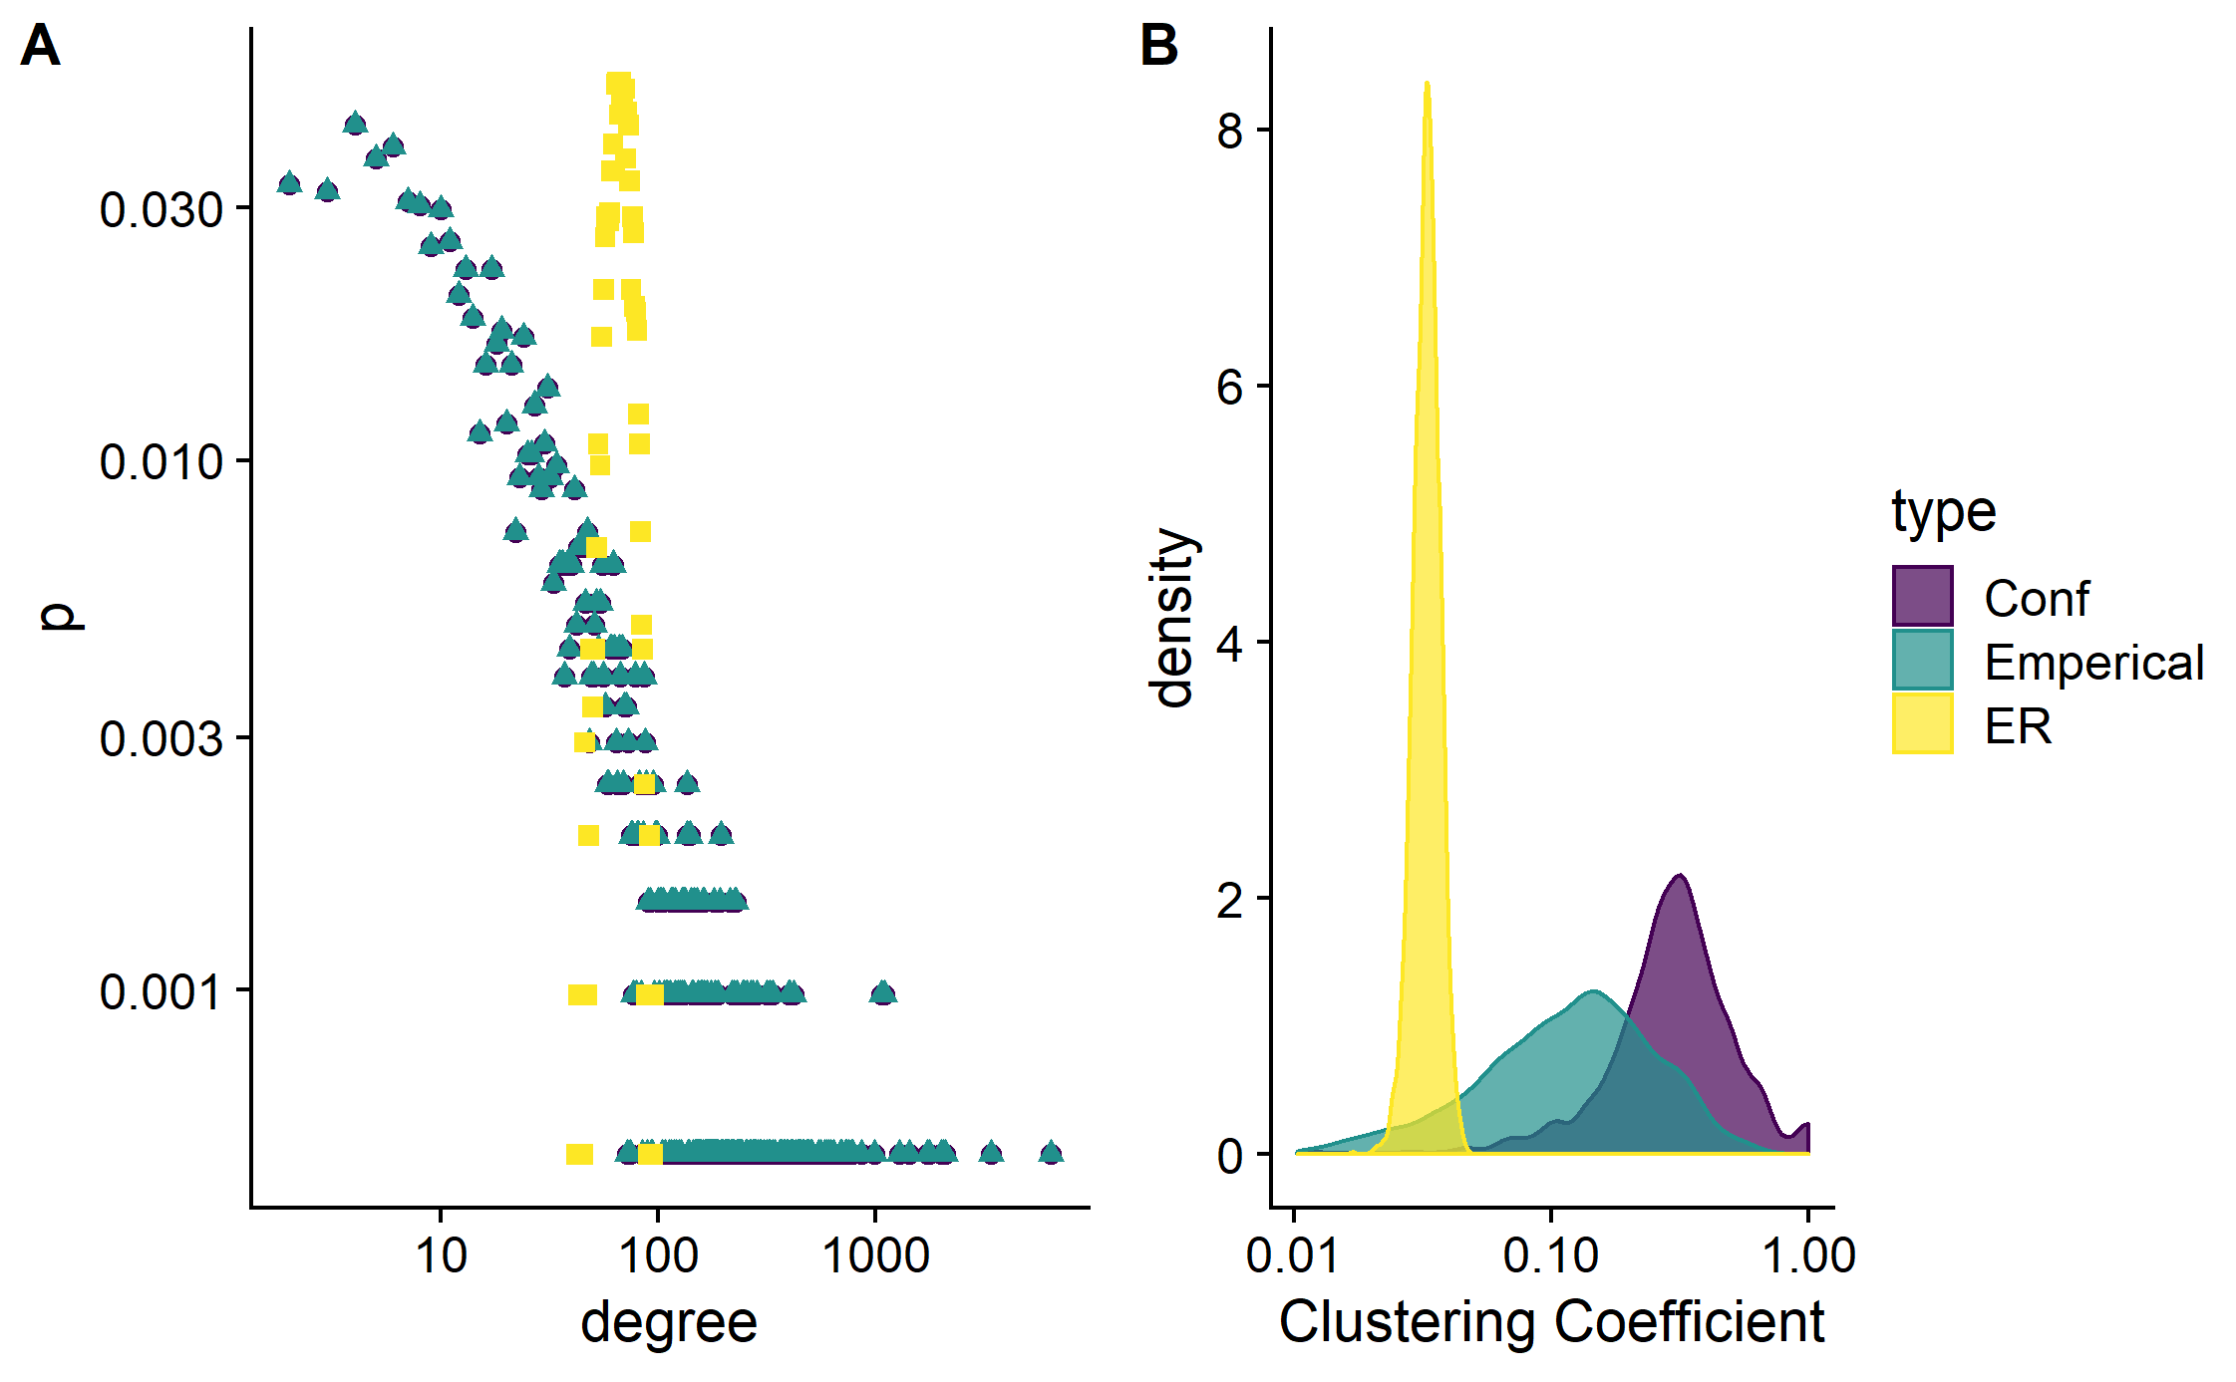
Network generation methods

Slide 34
Another little break to play with R
Network generation models
How would we generate similar networks to empirical observed networks?
Statistical networks
Ensembles properties of these random network
Convent to study
Erdos-Renyi model
Configuration model
2_descriptive.r

Slide 35
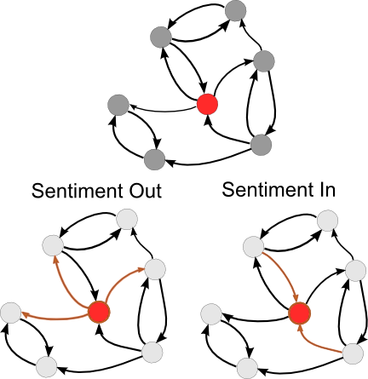
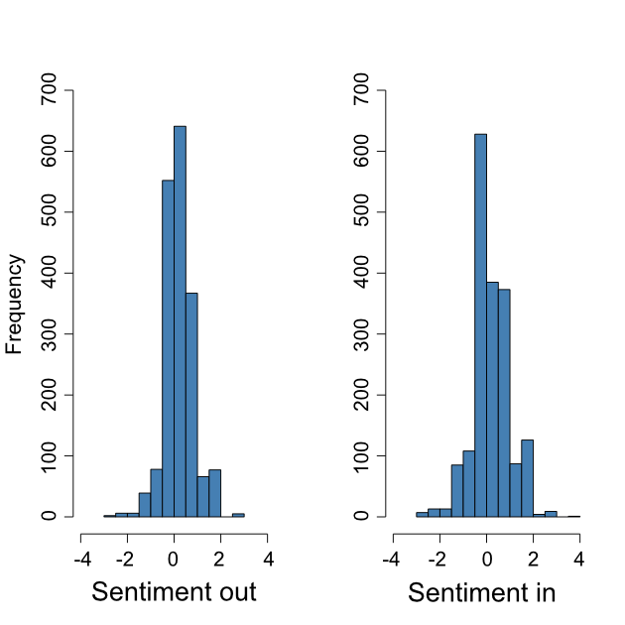
Tweet sentiment
Weight mentions network by sentiment
Calculate some nodal statistics
Average sentiment out
Average sentiment in
Correlation 0.59
How could these sentiment scores fail?
People may tweet out random nonsense
SentiStrength may be inaccurate
Given sentiment distribution & network topology
How likely are we to observe
Correlation
Connectivity between users

Slide 36
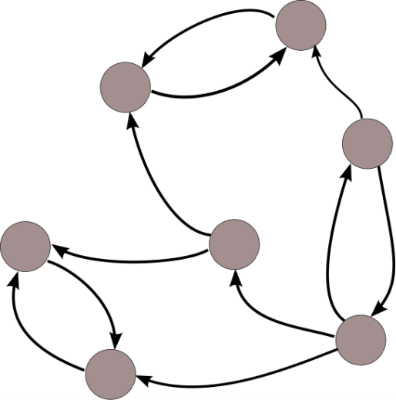
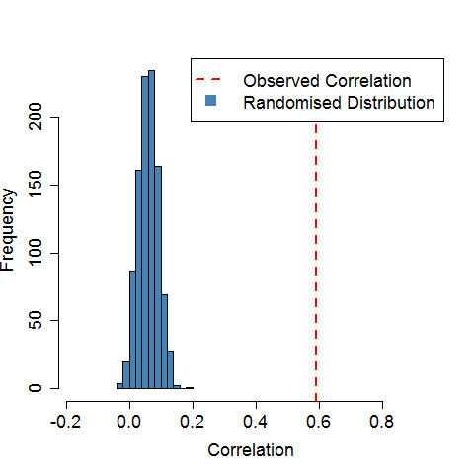
Randomisation tests
Correlation between sentiment in and out
Hold the network topology constant
Draw samples (with replacement)
Recalculate the correlation
Repeat M times
Compare randomised distribution to the observed correlation
What about the connectivity patterns?
(and not forgetting the follower network!)
s
s
s
s
s
s
s
s
s
s
s

Slide 37

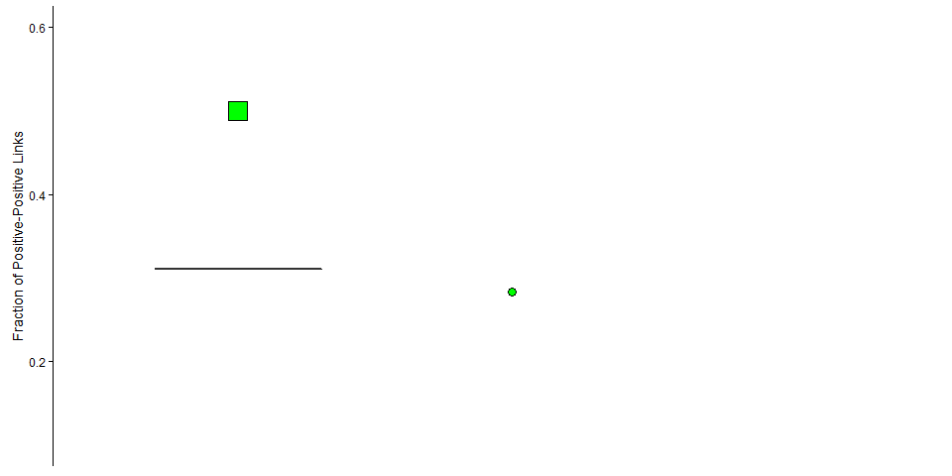
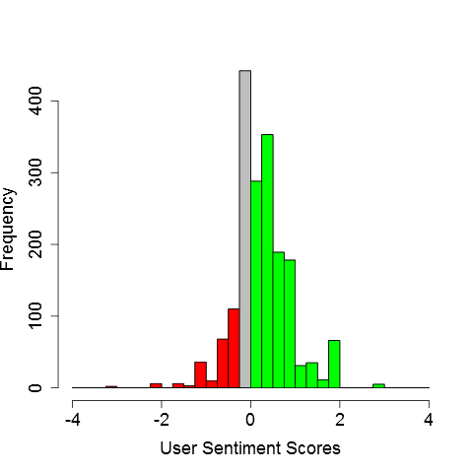


Sentiment & Homophily
Examine connectivity patterns
Observed fraction of
P-P links
23%
15%
62%
All connection types
Both networks
Simulated from
randomised network labels

Slide 38

Randomisation tests
Sentiment: correlation and clustering
Proxy for homophily, but still noisy…
Can we use this with groups of yes and no voters?

Slide 39
Again, another little break with R
So what did this analysis actually look like…
3_homophily_sentiment

Slide 40

Community detection
What is a community?
Types of communities?
Political networks?
Facebook?
Twitter?
How do we find them?
Hierarchical clustering
Modularity
Flow

Slide 41

Hierarchical clustering
Similarity based
Shared average cluster similarity

Slide 42
Hierarchical clustering
Current application
Fantasy sports

Slide 43
Hierarchical clustering
Slightly different network…

Slide 44
Hierarchical clustering
One type of node
Weighted
Temporal

Slide 45


Hierarchical clustering

Slide 46

Hierarchical clustering

Slide 47

Hierarchical clustering

Slide 48





Modularity, briefly
‘more density connected internally than externally’
Null model of a random graph to quantify quality of a community:
$$Q=\frac{1}{2m}\sum_{ij}^{​}{(}A_{ij}−\frac{k_{i}k_{j}}{2m})δ(c_{i},c_{j})$$
Optimizing this is NP-hard!

Slide 49

Modularity, briefly
Louvain Algorithm

Slide 50
Markov stability, again, briefly
Flow based methods

Slide 51
Again, another little break with R
So what did this analysis actually look like…
4_community_dectection.r

Slide 52


Community Detection
Markov stability on mentions and follower networks
Mentions
Partition into 2 communities
Follower
Partition into 6 communities
How could we combine information from both networks?
Like a unique partition that reflects both previous partitions
Refine both then cluster back together

Slide 53



Finding Yes & No Supporters

Slide 54
Community Detection
Markov stability on mentions and follower networks
Mentions
Partition into 2 communities
Follower
Partition into 6 communities
How could we combine information from both networks?
Like a unique partition that reflects both previous partitions
Refine both then cluster back together

Slide 55

Finding Yes & No Supporters
Use sentiment and community detection
What does makes up these three groups?

Slide 56



Community Detection and Sentiment
What about yes and no voters?
From each CC select random sample (20%) and classify
Hand classify as yes, no leaning or unaligned
How do we classify
Look at the tweets the user has sent
Profile description

Slide 57
Again, another little break with R
So what did this analysis actually look like…
5_community_aggregation.r

Slide 58

A little note on measuring performance
How do we measure our ability to find yes & no support?
Should really think about the best way to validate your model (a fair test)
Sometimes qualitative measures (fits) are good
Sometimes you a number, a quantitative measure
There is a lot to choose from!
Other options…

Slide 59

Finding Yes & No Supporters
Can do this in our case (or at least didn’t do this in our case)

Slide 60

Finding Yes & No Supporters
Can do this in our case (or at least didn’t do this in our case)

Slide 61


Finding Yes & No Supporters

Slide 62
Again, another little break with R
Back to the community detection with this one…
6_community_ detection_acc.R

Slide 63


Community Detection and Sentiment
What about yes and no voters?
From each CC select random sample (20%) and classify
Hand classify as yes, no leaning or unaligned
How do we classify
Look at the tweets the user has sent
Profile description
Redefine CC’s
Accuracy 89%
Balanced Accuracy 81%
How do these groups interact?

Slide 64
Activity between community clusters

Slide 65



Activity between community clusters

Slide 66

Activity between community clusters
Any thought?
How would you extend this work?

Slide 67
Cross Community Cascade diffusion
osullivan@maths.ox.ac.uk

Slide 68

Cascade
Dataset was extensive
Allowed us to generate retweet cascades
See how information spreads
Across the network
Between groups
How the cascades were created
Summarized
Comparison to synthetic cascades

Slide 69
Cascade
Dataset was extensive
Allowed us to generate retweet cascades
See how information spreads
Across the network
Between groups
How the cascades were created
Summarized
Comparison to synthetic cascades

Slide 70

Cascade Construction
Corpus identification
Goel et al., Management Science, 62, 180 (2015)

Slide 71

Cascade Construction
Patent attribution for tweets with common text
Goel et al., Management Science, 62, 180 (2015)

Slide 72




How to summarise the spread?
How can we best summarise the structure or size of a cascade?

Slide 73

How to summarise the spread?

Slide 74





The Cascades Models
We have
The empirical cascade & networks
Some cascade summary measures
(Focus on V(T))
Need synthetic cascades
ICM & LAM
Both
Popular models
Simple mechanisms
Capture global features
Fast to simulate
Simple contagion

Slide 75
Type of contagion models
Two types that are of interest in this setting
Simple contagion
Complex contagion
How do they spread differently?
Simple contagion
Faster on a network with high clustering or low?
Notes:
A susceptible node with i infected neighbors therefore is exposed to i independent sources of infection, so the probability that the node does not become infected in a time interval dt is (1 − β dt)^{i},
with the probability that the node does become infected being 1 − (1 − β dt)^{i}.
We define the transition rate FSIi by letting the probability of infection in a small-time interval dt equal FSIidt.
As dt → 0 this probability becomes, βi dt, and so the transition rate for a node with i infected neighbors is

Slide 76
Again, another little break with R
Back to the community detection with this one…
7_cascade_simulation.R

Slide 77

How did the models do?
If the model does well, the network structure accounts for the observed cascades
ICM
Not so good…
LAM
Better (qualitatively)
This is where we would normally stop and
Find the influence
Write a paper
Celebrate
But we have extra information
What is happening between the communities?

Slide 78




Information Diffusion

Slide 79
Information diffusion
How are we going to define when information spreads across communities?

Slide 80

Fine grained spreading behaviour
For each crossing death
If retweeted back inside the communities
Higher V(T)
If retweeted between communities
Lower V(T)
Preference for content?
Simple vs complex contagion?
How did the simulation do?

Slide 81

Fine grained spreading behaviour

Slide 82

Fine grained spreading behaviour

Slide 83

Fine grained spreading behaviour

Slide 84

Further work
Model extensions
Spreading mechanism (simple vs complex contagion)
Preference for content from different communities
Activity rates of users
Quality of content created

Slide 85
customer churn in mobile phone networks
osullivan@maths.ox.ac.uk

Slide 86

The company
Data Analytics Company
Sectors:
Gaming
Utilities
Mobile Telecoms
Involved in Social Network Analysis for:
Customer Acquisition
Identification of Households
Cross & up selling
Customer Retention
Identification of “churners”

Slide 87

Motivation
Goal
Model binary-state contagion to predict churn on a phone network
Why?
Significantly more expensive to attain a new customer than to retain an old one
Data
CDR Files
Weekly aggregated activity of users
Limited nodal attributes
Source: Aral, S., Muchnik, L., & Sundararajan, A. (2009). Distinguishing influence-based contagion from homophily-driven diffusion in dynamic networks. Proceedings of the National Academy of Sciences, 106(51), 21544-21549.

Slide 88
Data Analysis
They was a lot of data…

Slide 89
Data Analysis
Edge weights
Call, SMS & MMS frequency
Call duration
Max call duration
Nodal attributes
Handset type
Tariff
Gender
Sign on date
etc.
Descriptive Statistics

Slide 90
Data Analysis

Slide 91
Data Analysis
Filtering network:
Removed large degree nodes
Retained only reciprocal links

Slide 92



Data Analysis: Churn Events

Slide 93


Data Analysis
Probability of churn

Slide 94

Measuring Influence on a Node
Data cleaning:
Previously active churn period
Mutual connections
Remove nodes with large degree
For each variable:
let $x_{ij}$ be the edge weight from node $v_{i}$ to $v_{j}$
For the node $v_{j}$ compute:
$I_{j}^{C}=\sum_{v_{i}∈V_{j}^{C}}{x_{ij}}$
$I_{j}^{N}=\sum_{v_{i}∈V_{j}^{N}}{x_{ij}}$
Use these and nodal attributes to build a statistical model for prediction of churn events

Slide 95
Classification Models
Classification Trees:
Repeatedly creates binary splits of the data for a set of variables:
Low bias
High variance
Suffers from overfitting
Basis for more robust methods of classification

Slide 96
Classification Models
Random Forests
Builds on classification tree methods:
Boosts performance by using
Bagging (bootstrapped subsample method)
Random subspaces (random feature selection)
Builds a “forest” of classifiers (majority vote)
Results: low bias, low variance & reduces overfitting

Slide 97
Again, another little break with R
Back to the community detection with this one…
8_random_forest.R

Slide 98


Validation:
Lift metric:
Measures performance of classifier
$lift=\frac{targeted chrun rate}{average churn rate }$
Validated on an independent dataset
Reduced dataset
40,000 nodes aprox.
Best performance
Captures very small cohort
Full dataset
3,000,000 nodes aprox.
Comparable performance with Idiro’s method
Captures larger group

Slide 99
Conclusions
Gained insights into:
Nodes propensity to churn given number of churner neighbours
Churner-churner configurations
Time between churn events
Developed a classification model for churn
Comparable performance to companies current method
Predicts a different cohort of individuals
Model is faster to train than current the companies method
Allows an ensemble of prediction methods to be used

Slide 100
customer churn in mobile phone networks
osullivan@maths.ox.ac.uk

